Slide 1




Bias in NLP
Investigating the Impact of Annotator Gender on Bias in Toxic Language Detection Systems
Elizabeth Excell

Slide 2
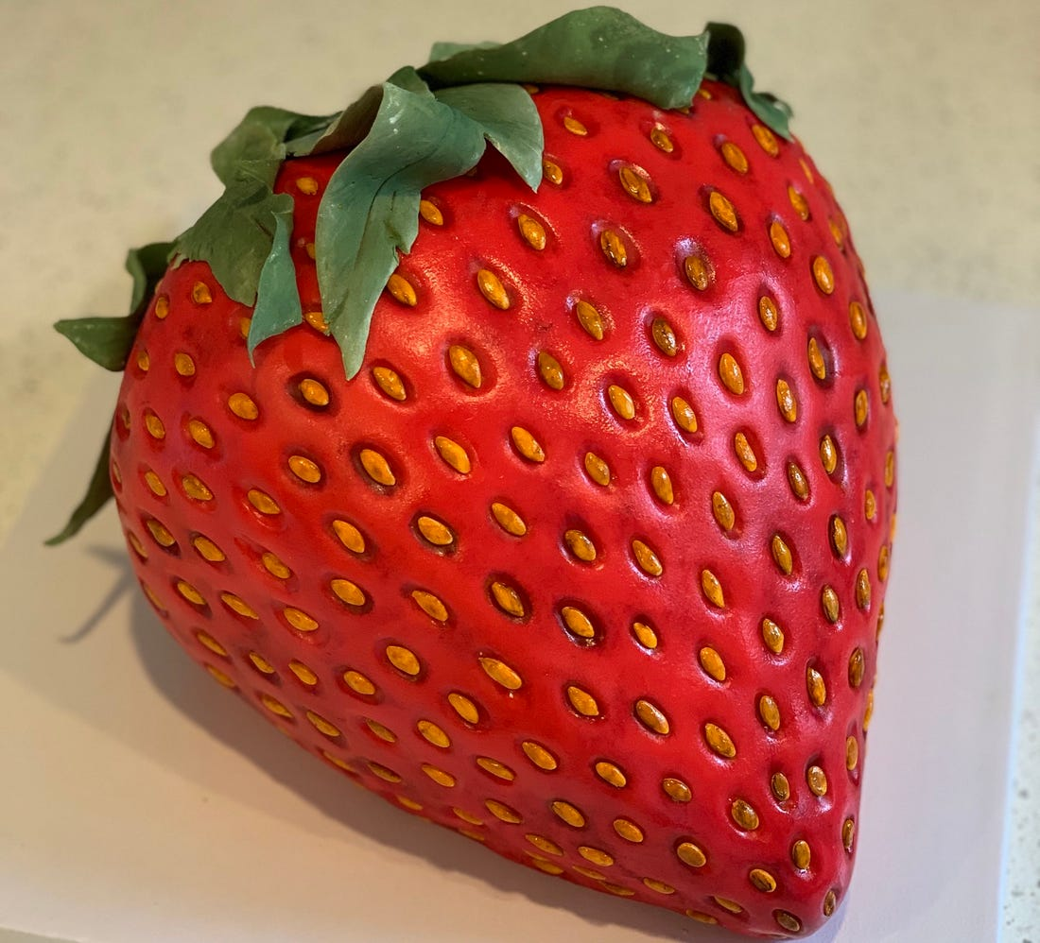
What is this? (Not a trick question)

Slide 3


CAKE!

Slide 4
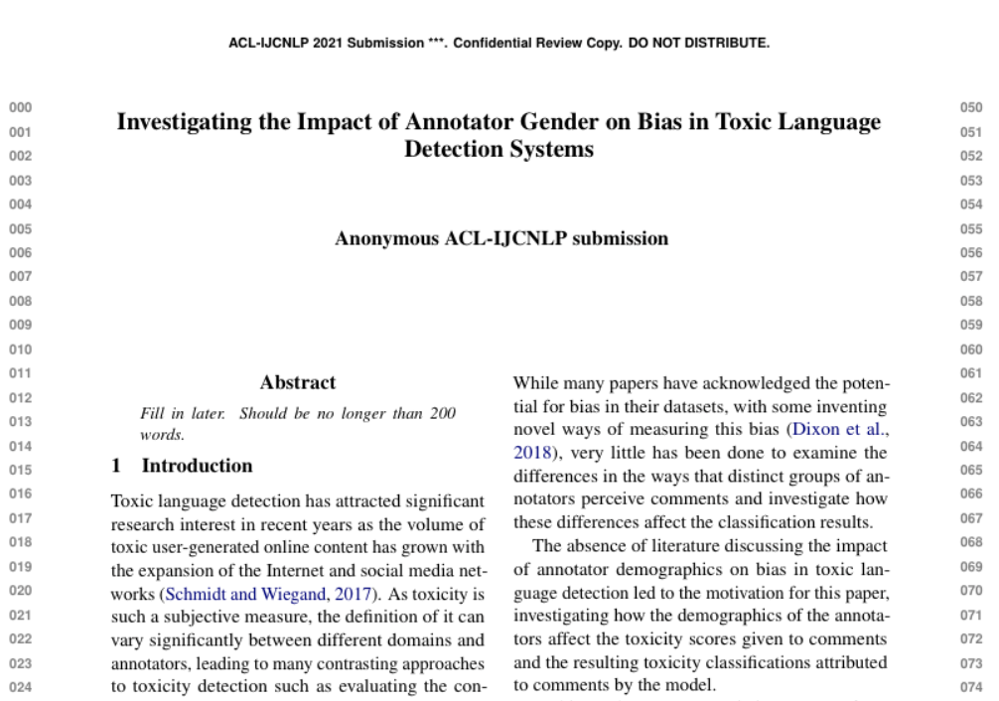
Paper in progress

Slide 5
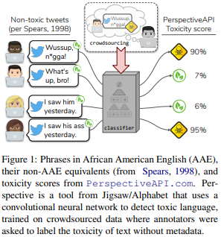
(Quick Sidenote)
Sap, M., Card, D., Gabriel, S., Choi, Y. and Smith, N.A., 2019, July. The risk of racial bias in hate speech detection. In Proceedings of the 57th annual meeting of the association for computational linguistics (pp. 1668-1678).
https://www.aclweb.org/anthology/P19-1163.pdf

Slide 6
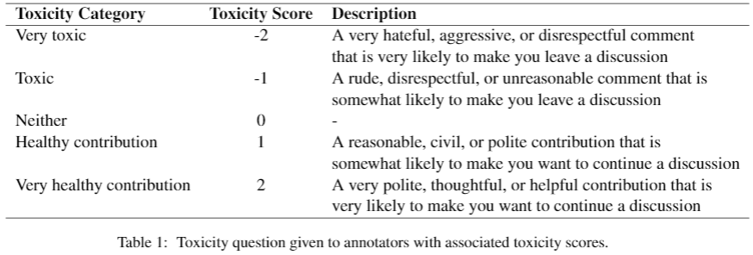
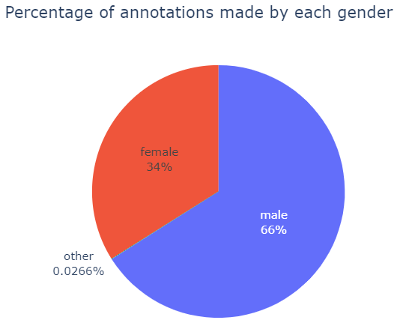
Dataset
160k comments from English Wikipedia
Female annotators on average classified 1.72% more comments as toxic than male annotators
Female annotators on average gave comments 0.048 lower scores (more toxic) than male annotators
Ellery Wulczyn, Nithum Thain, and Lucas Dixon. 2017.Ex machina: Personal attacks seen at scale. In Proceedings of the 26th international conference on world wide web, pages 1391–1399. https://dl.acm.org/doi/abs/10.1145/3038912.3052591

Slide 7

Can’t we just balance the data?
There may also be bias in the classifier
There may be patterns in the data that we can’t see
Extra Information:
Men have a higher inter-annotator agreement than women
Classification relies on the majority opinion of the group

Slide 8
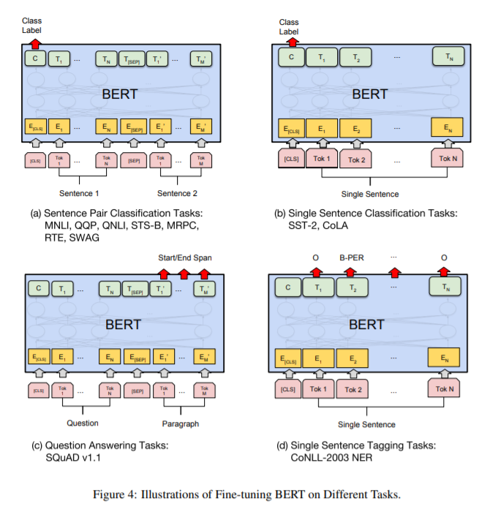
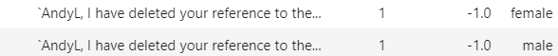
Gender Classification
(Gender)
Data: toxic comments balanced by gender of annotator and toxicity score
Input: toxic comment
Output: gender prediction
Devlin, J., Chang, M.W., Lee, K. and Toutanova, K., 2018. Bert: Pre-training of deep bidirectional transformers for language understanding. arXiv preprint arXiv:1810.04805.
https://arxiv.org/pdf/1810.04805.pdf

Slide 9
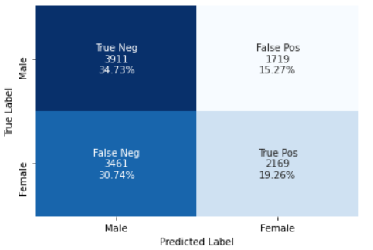
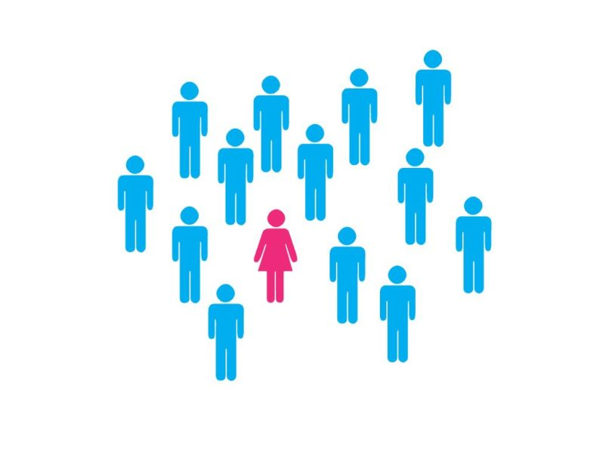
Results…
Bias towards predicting men as the annotators of toxic comments

Slide 10
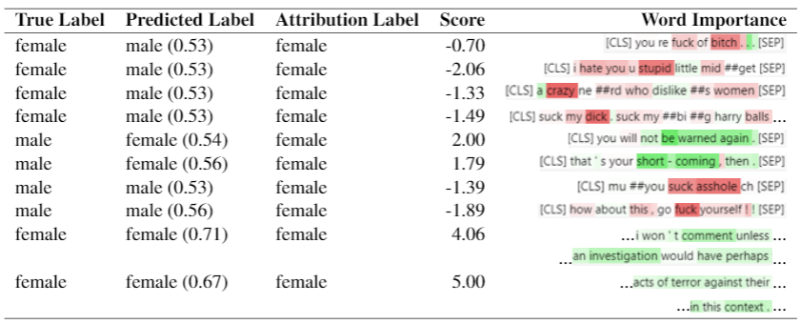
Remember the practicals?

Slide 11
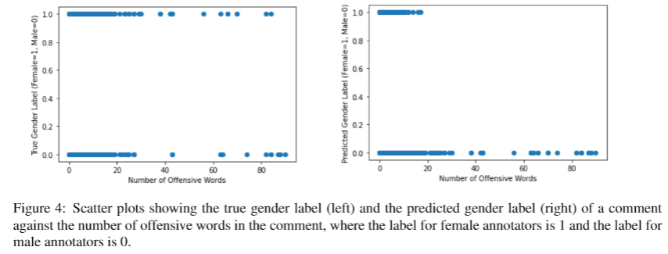
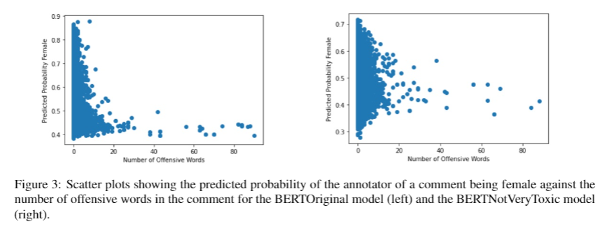
Validation
All comments annotated by women containing high numbers of offensive words are predicted as having been annotated by men
Gender predictions are more scattered once offensive words and the most toxic comments have been removed from the training data

Slide 12
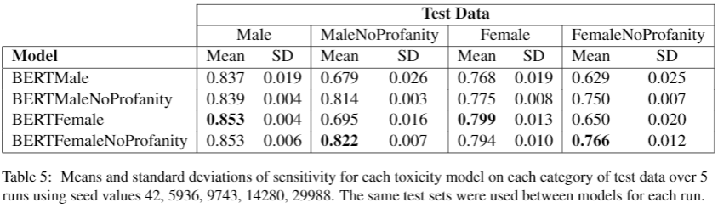
Toxicity Classification
Female test data performs worse than male test data
Female models perform better than male models
Test data without offensive words is harder to classify as toxic
Models trained without offensive words perform surprisingly well on all test data, always comparable to/better than their counterparts

Slide 13
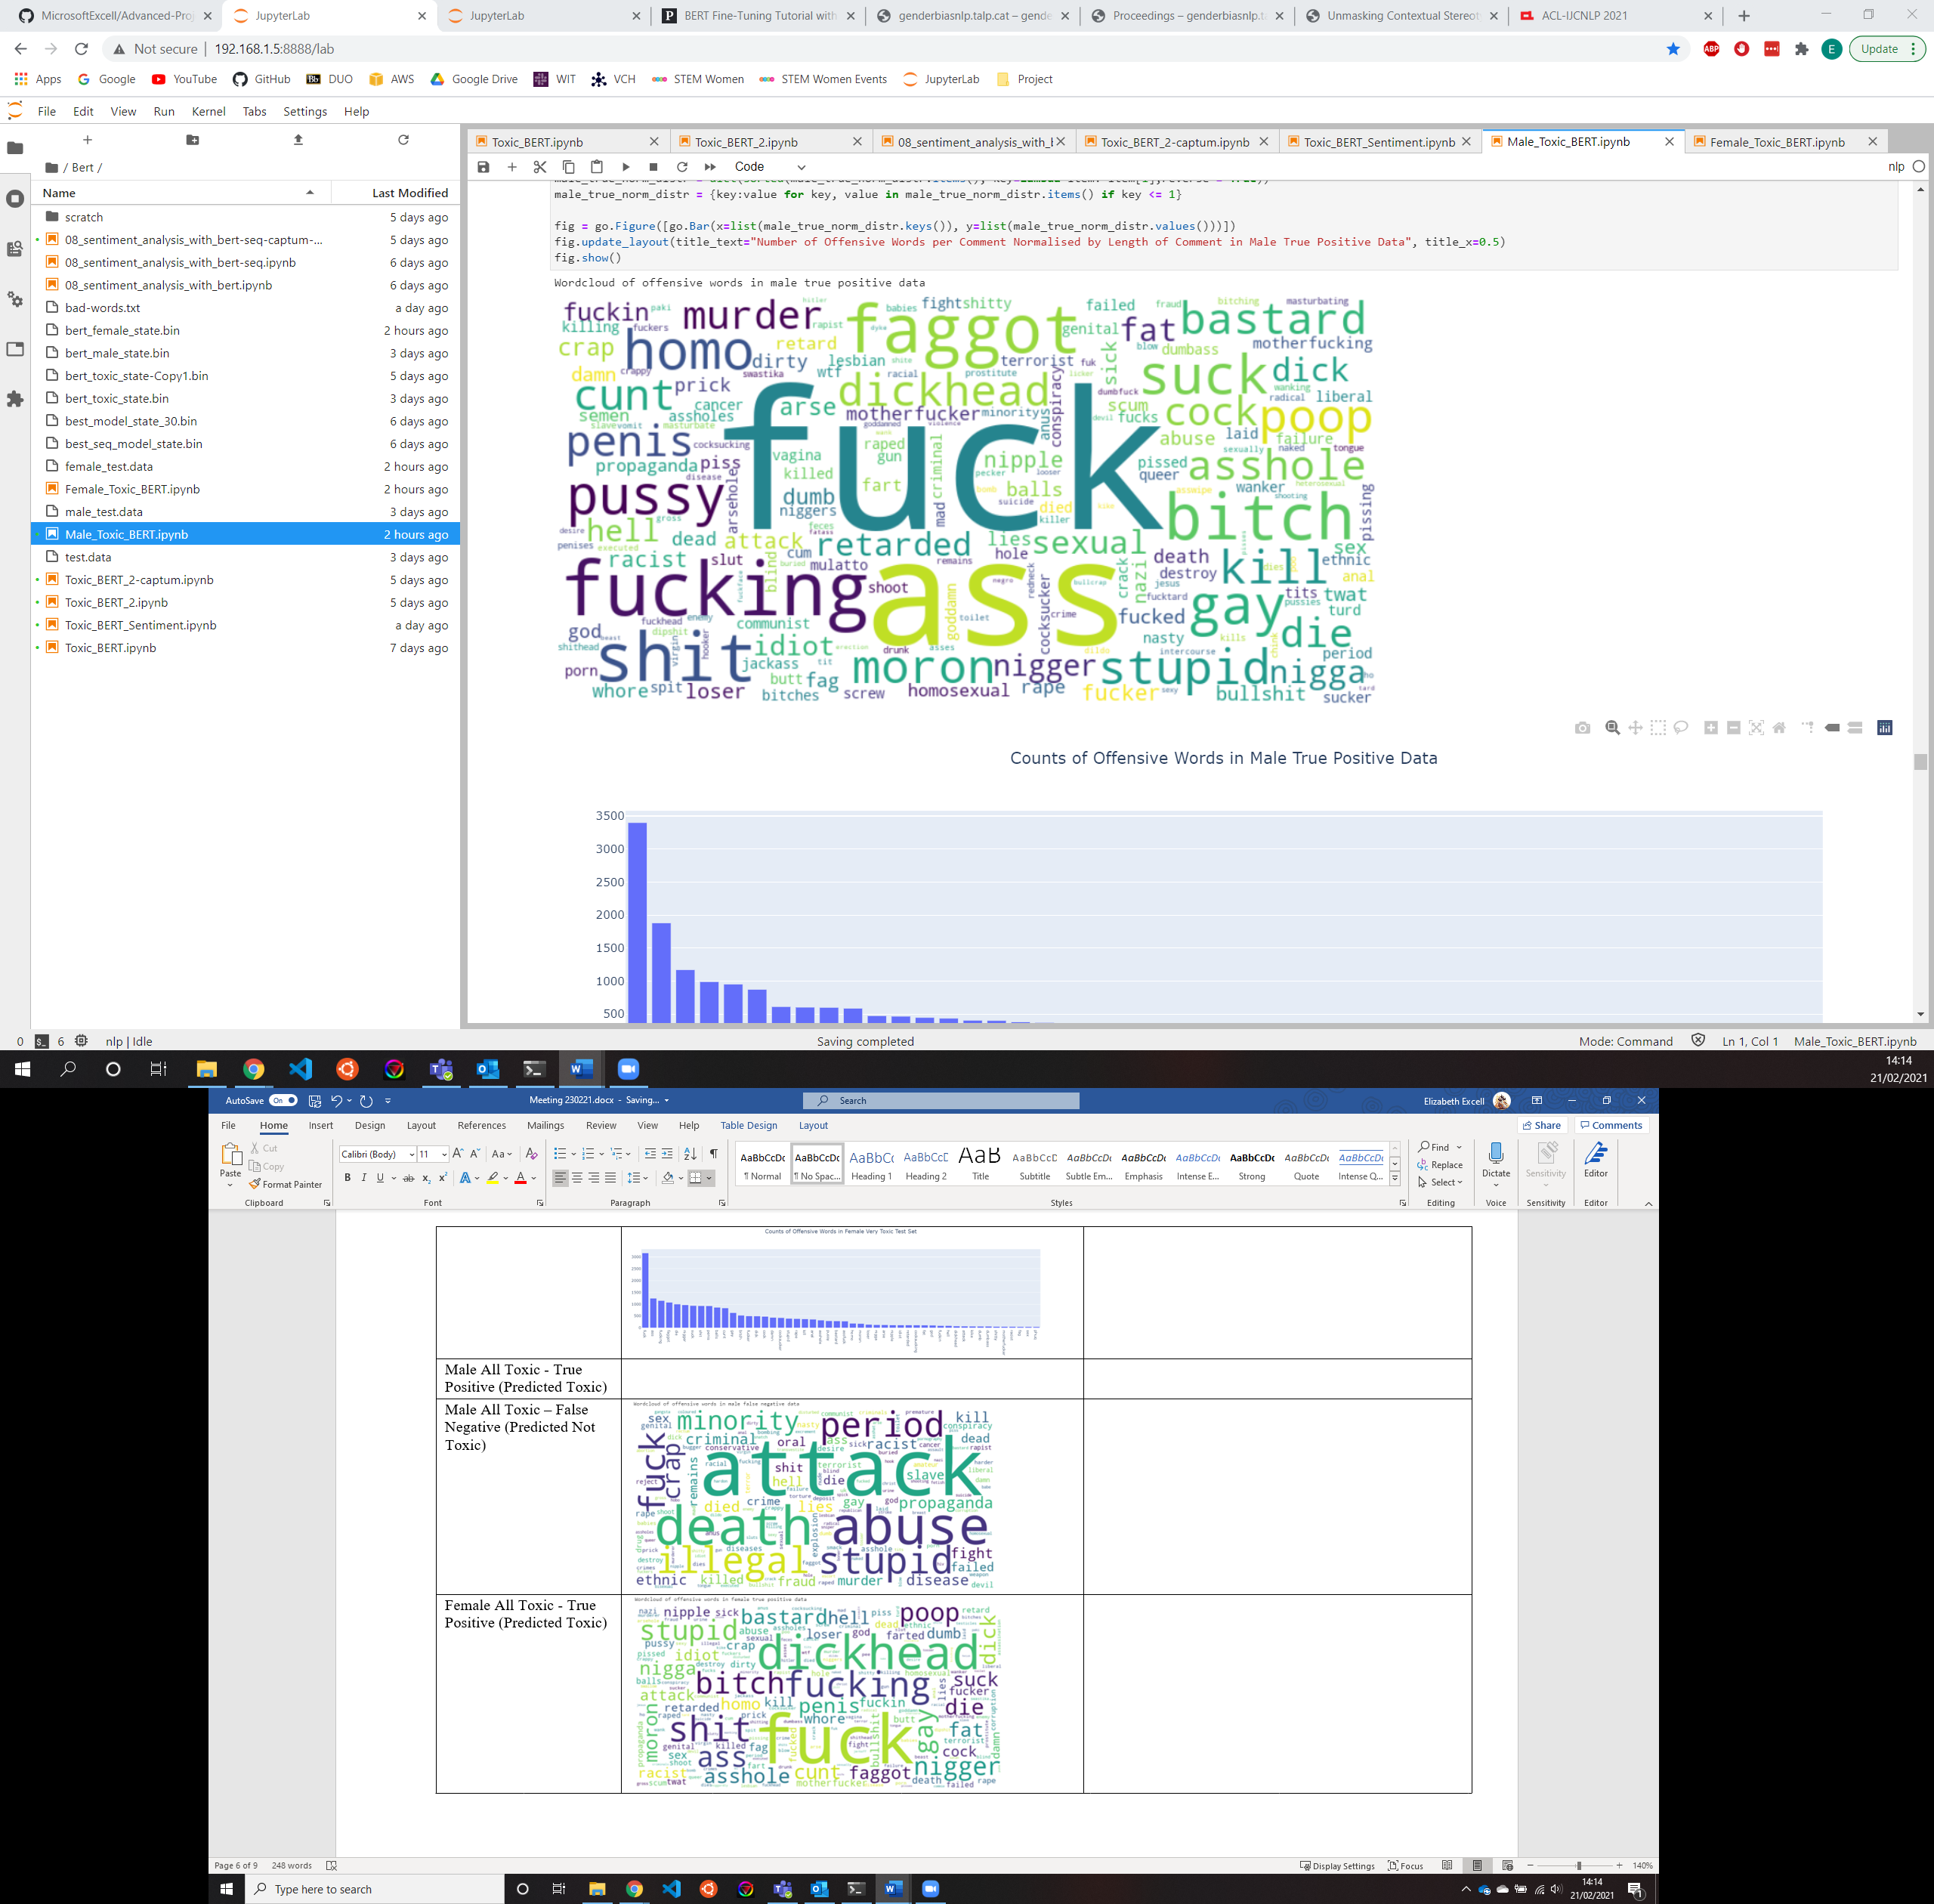
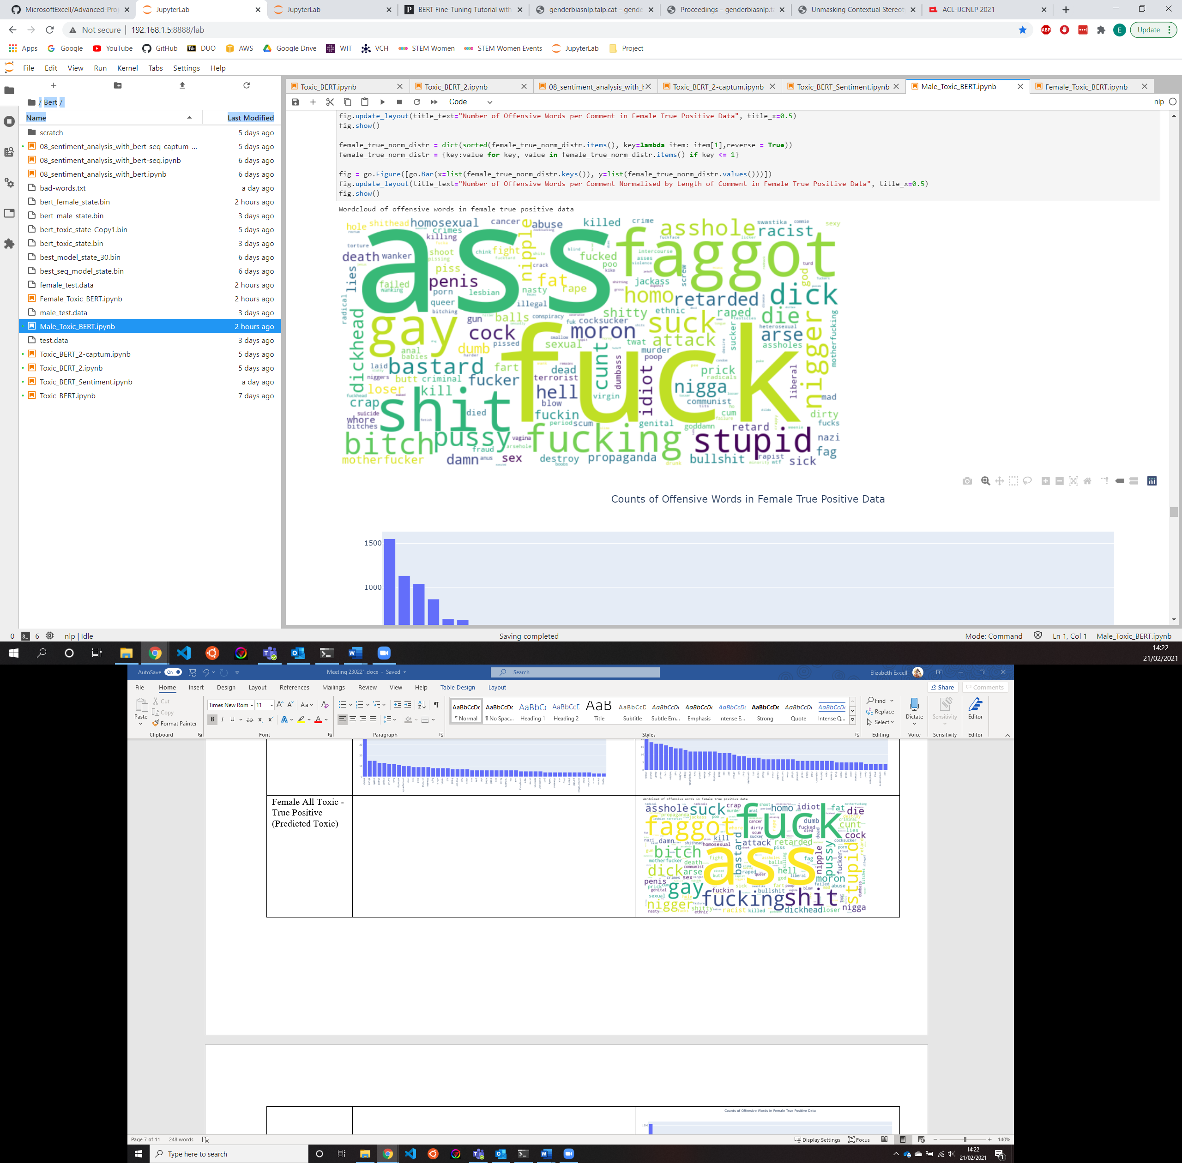
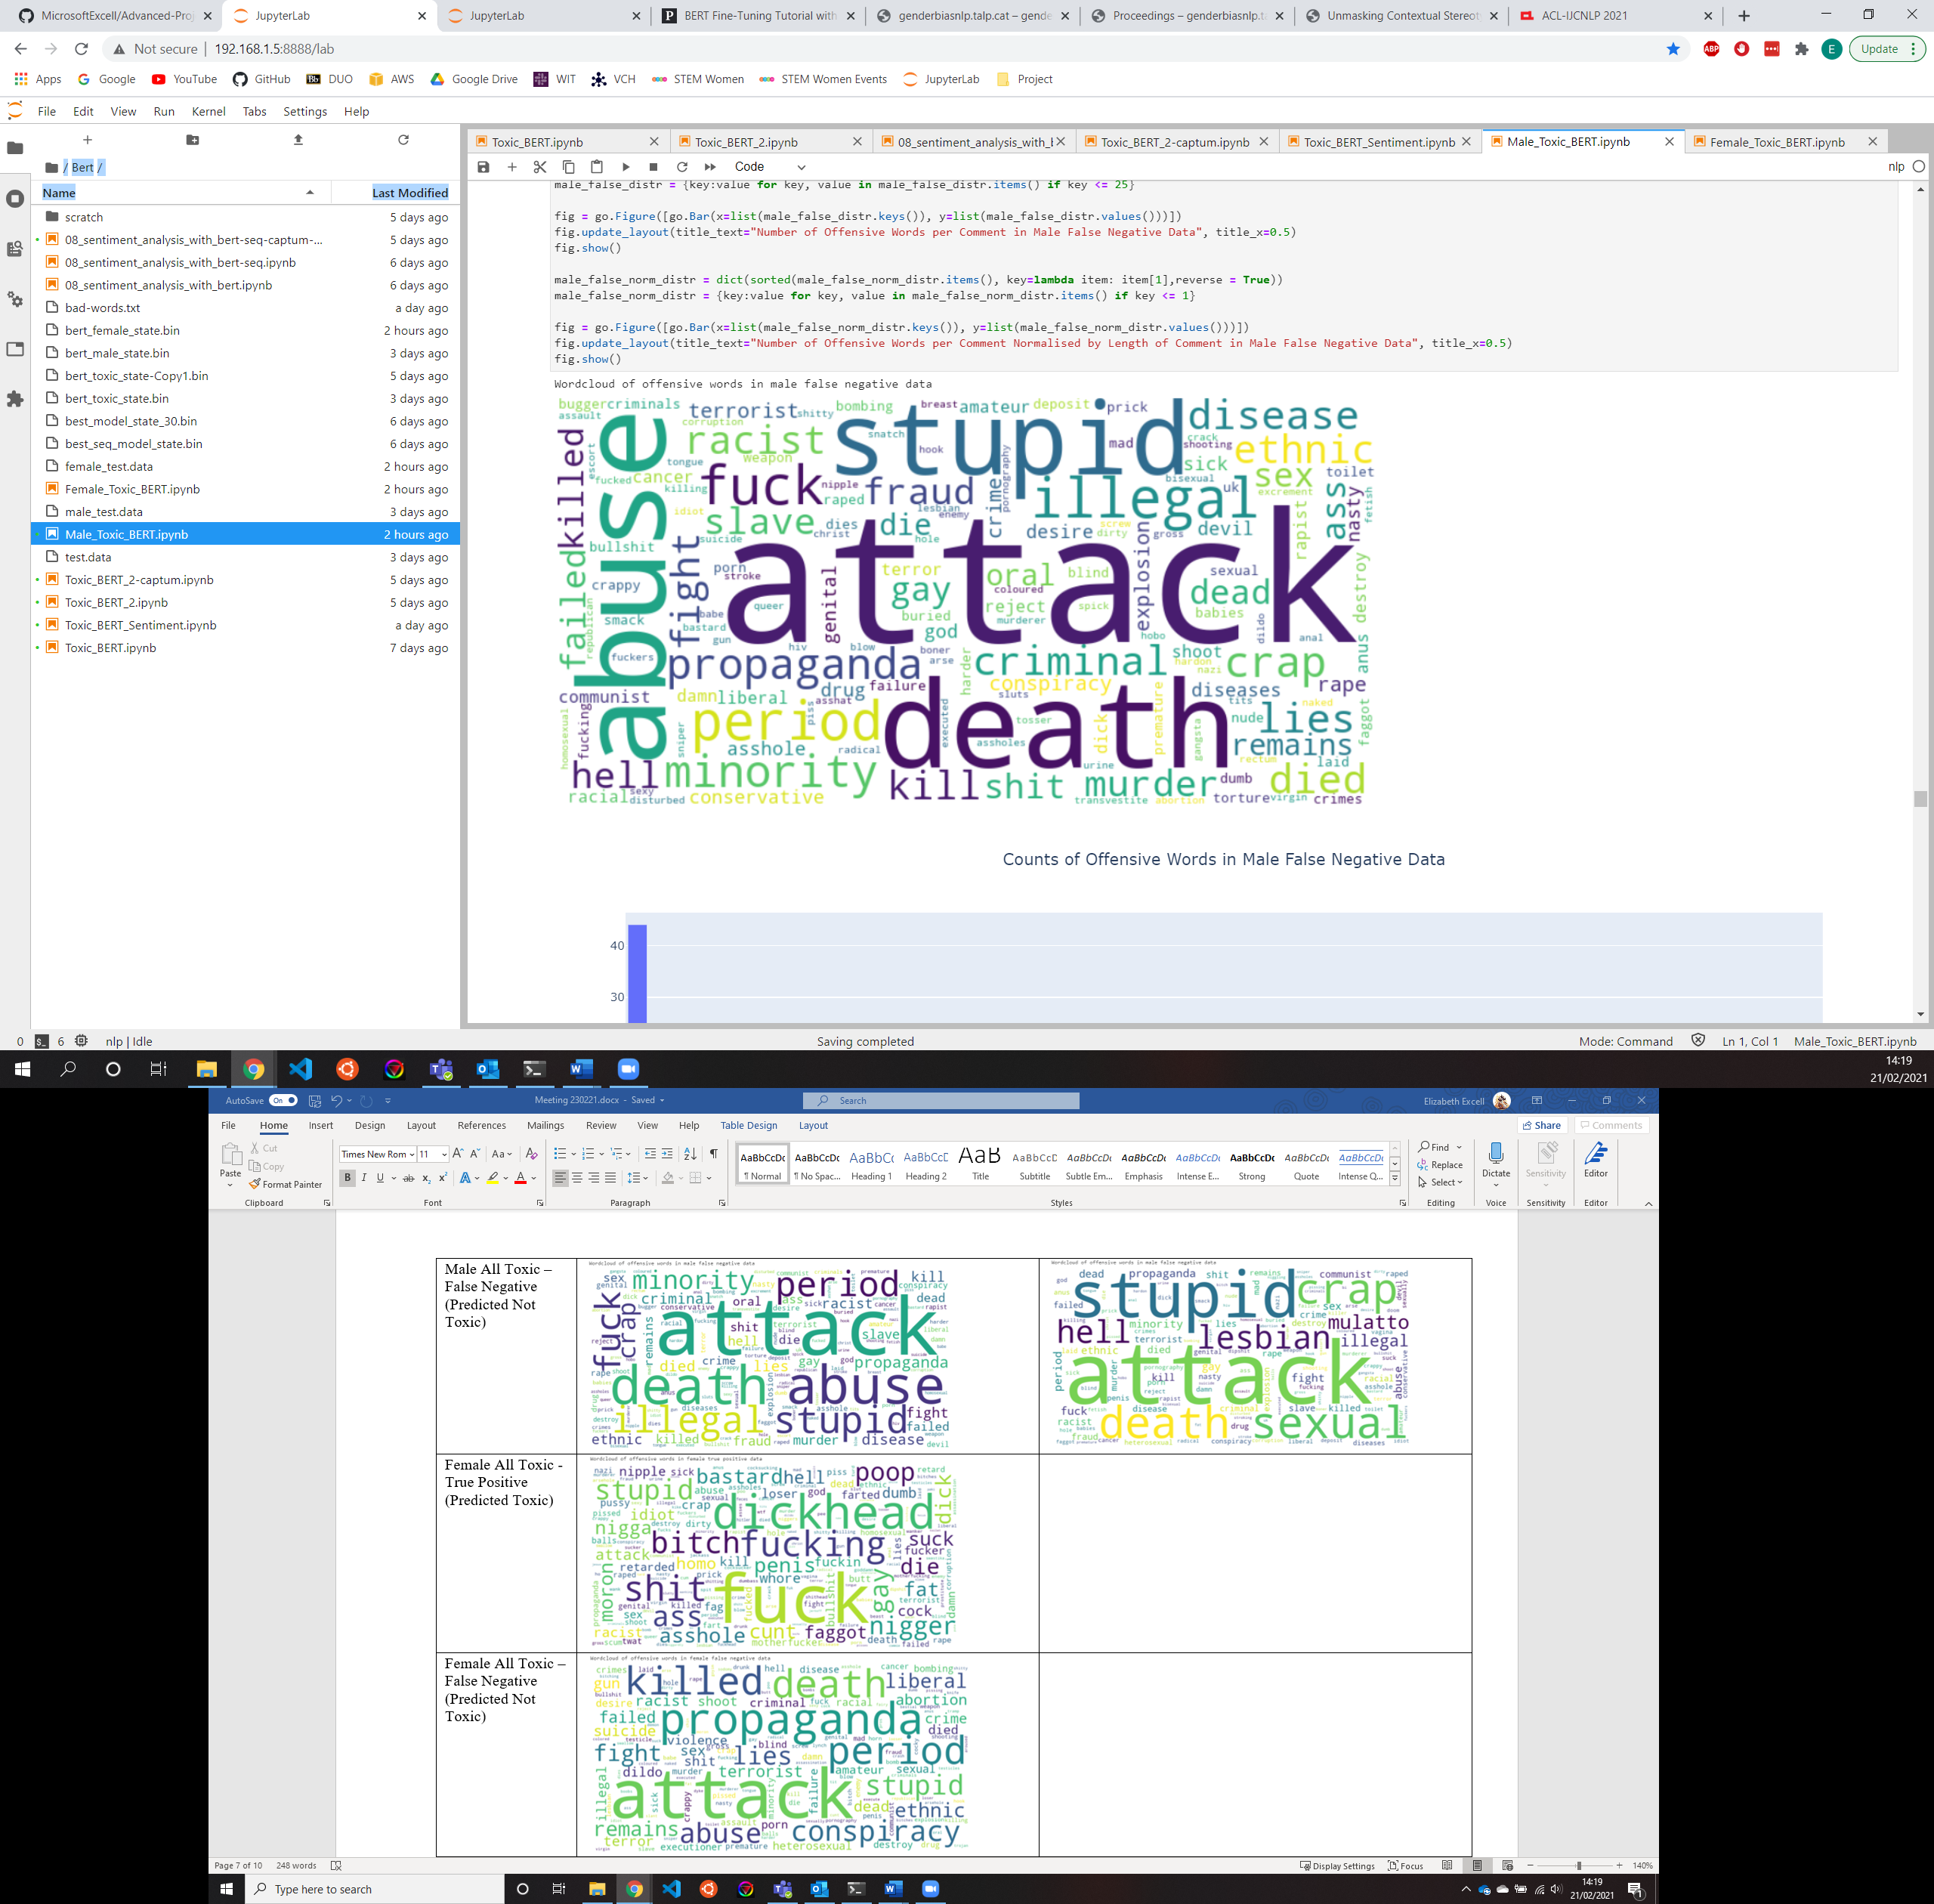
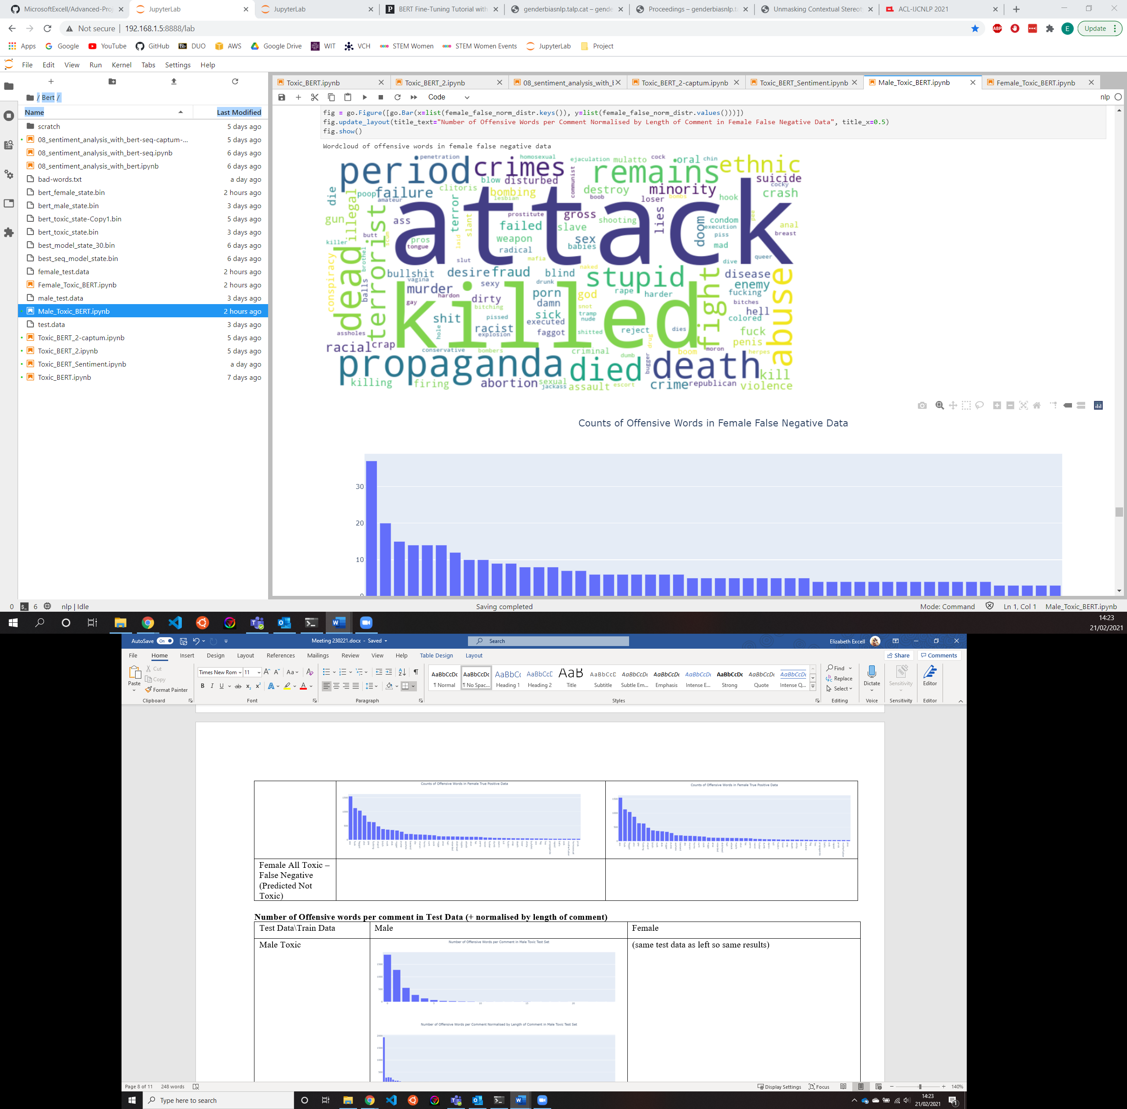
Other Results…
 | Male Test Data | Female Test Data
True Positive (correctly classified as toxic)
False Negative

Slide 14
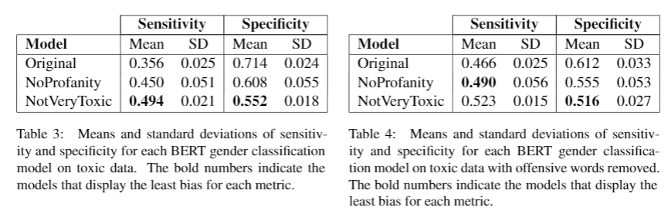
Other Results…

Slide 15

This Photo by Unknown Author is licensed under CC BY-SA

